Slide 1

ESG Text-to-SQL AI Assistant
AI assistant for ESG data, instantly turning natural language queries into insights with advanced Natural Language Processing and LLM capabilities.

Slide 2
The Data Bottleneck
•
Lack of SQL Knowledge: ESG stakeholders, auditors, and management need insights instantly but cannot write complex queries.
•
Technical Dependency: Retrieving basic ESG metrics requires data analysts, resulting in reporting delays.
•
Siloed Information: Analyzing diverse Environmental, Social, and Governance metrics manually across disconnected tools is highly inefficient.
•
Rigid Dashboards: Traditional BI tools fail to answer spontaneous, ad-hoc sustainability questions.

Slide 3









AI-Powered Solution
Natural Language
Automated SQL
Instant Insights
Users ask ESG questions in plain English (e.g., "Show Scope 1 emissions in Singapore for FY25").
The GenAI engine understands metadata to automatically convert conversational questions into optimized SQL queries.
Retrieves data and automatically recommends the best visualization, providing actionable summaries.

Slide 4
System Architecture Flow
RAG & Metadata
Validation & Viz
Injects context using Vector DB containing ESG glossary, KPI rules, and data dictionary.
Secures query, executes retrieval, and generates dynamic charts & conversational answers.
Intent Parsing
SQL Generation
AI identifies the ESG Metric, Business Entity, Time Period, and Geographies requested.
LLM formulates optimized SQL tailored

Slide 5
Technical architecture
Architecture with the major components and their responsibilities.
Grounding
Vector embeddings and Knowledge graph
Streamlit UI
Application
Validation
Execute SQL
SQL Engine
Output
Question / results
Request orchestration
Schema + safety
Insights, charts and summary
LLM layer
Prompting + SQL generation

Slide 6
Project structure
Key modules and what each part is responsible for.
src/app.py
Streamlit entry point: chat interaction, result display and visualization.
src/llm/
LLM-facing logic: prompts, SQL generation and related AI processing.
src/rag/
Document loading, chunking, embeddings, Chroma vector-store ingestion and retrieval.
src/grounding/
Grounding abstraction plus graph and embedding retrievers / comparison tests.
src/database/
Database inspection and schema access for the SQLite dataset.
src/services/
Result summarization, visualization and supporting application services.
data/
ESG dataset, knowledge metadata, knowledge graph JSON and source documents.
chroma_db/
Persistent vector database created from the document knowledge base.

Slide 7
What the application does
1
2
3
4
5
6
User question
Intent / context
Grounding
LLM SQL generation
Validation
Insight
Plain-English user queries
Identify metric, dimensions, filters and time
Resolve business terminology to relevant ESG metrics and dimensions
Generates SQL by combining the user's intent, database schema, and business context.
Reject unsafe / invalid SQL before execution
Table, visualization and natural-language result

Slide 8


Core GenAI Engine
Large Language Model (LLM)
Retrieval-Augmented Generation (RAG)
Powering the core intelligence of the application. Responsible for Intent Classification, complex SQL Generation, and Contextual Summarization. It translates strict reporting standards into natural conversational output.
Ensures zero-hallucination accuracy. Utilizes ChromaDB to store and retrieve vital ESG Metadata, Column Descriptions, Table Relationships, and Business Context, directly grounding the LLM before SQL is generated.

Slide 9
LLM — Where It Is Used
The project uses the LLM at three distinct points in the query lifecycle.
01
02
03
Intent Classification
SQL Generation
Insight Generation
Classifies the user's request before SQL generation.
• READ — valid ESG analytics query
• WRITE — database modification request
• OFF_TOPIC — unrelated or invalid request
Output: READ / WRITE / OFF_TOPIC
Converts the request into one SQLite SELECT statement.
Uses:
• User question & intent
• Database schema from get_schema()
• Grounding / ESG business context
• Relevant conversation history
Turns query results into a concise business summary.
The LLM:
• Highlights highest / lowest values
• Identifies visible trends
• Makes significant comparisons
• Avoids SQL terminology
Configured model in the current project: GPT-OSS-120B through the project's LLM API configuration.

Slide 10
RAG / embedding-based knowledge base
Knowledge source
Vector retrieval
What the LLM receives
PDF documents contain: • ESG data dictionary • KPI definitions • SQL metadata / generation guidance • Business synonyms These documents are loaded, split into chunks and embedded.
BGE embedding model converts text into vectors. ChromaDB stores the vectors and metadata. At query time, the question is embedded and the most similar chunks are retrieved.
User question , Retrieved ESG business context , Database schema ,and Conversation history, when relevant
Trade-off: retrieval ranking can return related context without guaranteeing the exact required column mapping.
Retrieval is based on semantic similarity, so relevant-but-not-exact chunks can be returned.
Embedding model used by the project: BAAI/bge-base-en-v1.5

Slide 11
SQL validation & execution
The generated SQL is treated as untrusted output until it passes validation.
SQL safety
Schema validation
Execution
Only read-only SELECT queries are supported. The validator rejects destructive / unsupported operations such as: DELETE, UPDATE, INSERT, DROP, ALTER, CREATE, MERGE, TRUNCATE, PRAGMA, ATTACH, DETACH.
SQLGlot parses the generated SQL and analyzes its AST.
SQLAlchemy Inspector reads the live database schema and validates referenced tables and columns.
Allows only a single read-only SELECT statement and rejects unsafe/unsupported SQL operations.
Rejects unknown tables, columns, and identifiers before the query reaches the database.
Enforces a maximum 1,000-row limit before execution, providing a safety boundary between the LLM and database.
Only after validation does the query reach SQLite. The returned dataframe becomes the input for visualization and natural-language result summarization.

Slide 12
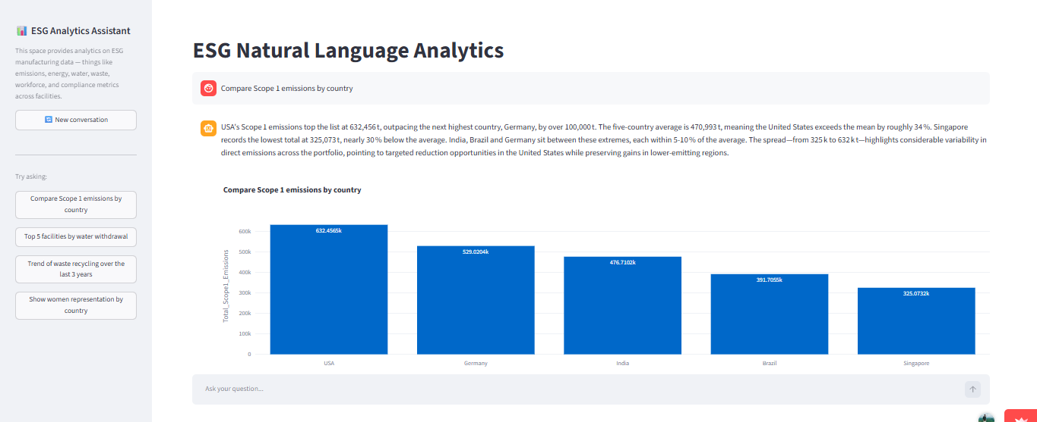
Results, visualization & conversational answer

Slide 13
Knowledge graph approach
JSON contains
How the graph works
Key characteristics
• KPI definitions • Dimension definitions • Physical DB column names • Human-readable names • Business aliases / synonyms • Aggregation rules • Units • Grouping guidance
User question is matched against KPIs, dimensions and aliases
Exact business terms are resolved to known database columns
Business synonyms can map to multiple KPIs
Relevant aggregation and grouping rules are included
Produces structured grounding context for SQL generation
No embedding model is required for graph resolution
Deterministic: same input → same grounding result
Schema-aware: mappings point to actual DB columns
Explicit: business terminology is defined rather than inferred
Lightweight: JSON loaded into memory at startup
Maintainable: new KPIs, aliases and dimensions can be added directly
Fast: no model inference during grounding

Slide 14
Graph vs Embeddings-grounding comparison
Context grounding recall
Knowledge Graph
0.91
Context grounding recall
Embeddings
0.87
Average latency / query
Knowledge Graph
0.8 ms
Average latency / query
Embeddings
98.2 ms
Structural precision
Knowledge Graph
0.98
Structural recall
Knowledge Graph
0.91
Interpretation
For the current small, controlled ESG schema, explicit JSON grounding is slightly more accurate in this benchmark and dramatically faster; embeddings remain useful for broader / less controlled language.

Slide 15
Live Demo Time
Ready to see the Text-to-SQL Assistant in action?

